Slide 1
Lecture 7
Operating Systems (COMP1562)

Slide 2

File Systems
Files are an abstraction mechanism
a method of storing data for later retrieval (usually on disk)
large storage capacity
non-volatile, persistent – data survives termination of the process using it
multiple processes can concurrently access data
File system is considered part of the operating system
Mariusz Pelc © 2012/2013
(with support from Dr Kevin McManus and Cos Ierotheou)

Slide 3
File Attributes
Name
Type
Location
Size
Access rights
Access/Modification/Creation time
Extended attributes
ACL (Access Control List)
Mariusz Pelc © 2012/2013
(with support from Dr Kevin McManus and Cos Ierotheou)

Slide 4
File Naming
Case sensitive
foo, Foo and FOO are different files
Case insensitive
foo, Foo and FOO are the same file
Extensions used to indicate file contents
convention - UNIX
mandate – DOS, Windoze
e.g. myprog.c.Z
Mariusz Pelc © 2012/2013
(with support from Dr Kevin McManus and Cos Ierotheou)

Slide 5
File Types
Ordinary files
Directories
Symbolic links
Named pipes
Sockets
Block devices
Character devices
Mariusz Pelc © 2012/2013
(with support from Dr Kevin McManus and Cos Ierotheou)

Slide 6
File Structures
Logical structure
Describes how the information is being organised in the file
Can be defined at the Operating System or application level
Usually related to type/function of a file (graphical file, text file, etc.)
Physical structure
Describes how the information is being stored in the file
Is strictly related to the device type where the file is stored
Can be defined at the Operating System level in the kernel or in the user space
Mariusz Pelc © 2012/2013
(with support from Dr Kevin McManus and Cos Ierotheou)

Slide 7
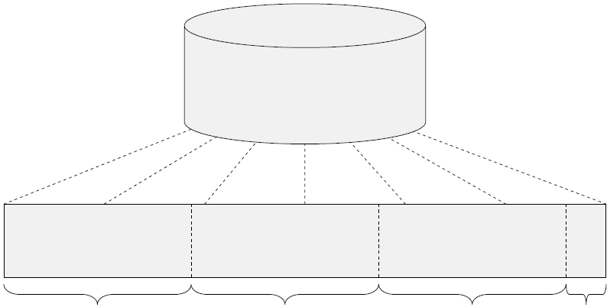
File Structures
Physical Storage
file
Logical record
Logical record
Logical record
Free
space
Mariusz Pelc © 2012/2013
(with support from Dr Kevin McManus and Cos Ierotheou)

Slide 8
Files – access methods
Sequential access
Information is processed record after record
Possible operations:
Reading the next record/block
Adding a record at the end
Changing current position pointer
Direct access
Location of a record to be processed is given as the argument of adequate operation
Indexed access
Records are identified via special index keys
Faster access in comparison to the free access
Mariusz Pelc © 2012/2013
(with support from Dr Kevin McManus and Cos Ierotheou)

Slide 9
File Operations
Create : joe file, notepad file
Delete : rm file, del file
Open : open()
Close : close()
Read : read()
Write : write()
Append : cat file >> another_file
Seek : lseek()
Get attributes : fgetattr()
Set attributes : fsetattr()
Rename (move) : rename()
Mariusz Pelc © 2012/2013
(with support from Dr Kevin McManus and Cos Ierotheou)

Slide 10
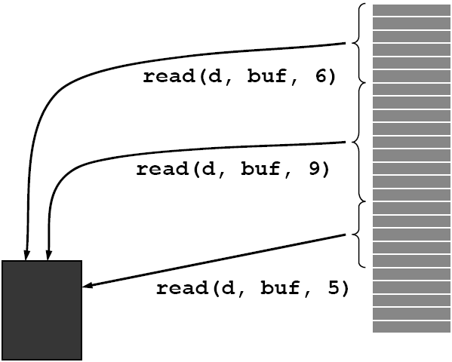
Files – access methods
Buffer
in the
memory
file
Mariusz Pelc © 2012/2013
(with support from Dr Kevin McManus and Cos Ierotheou)

Slide 11
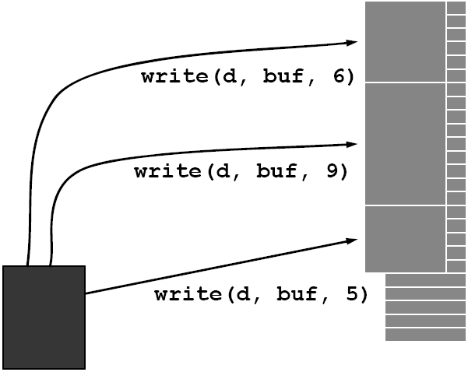
Files – access methods
Buffer
in the
memory
file
Mariusz Pelc © 2012/2013
(with support from Dr Kevin McManus and Cos Ierotheou)

Slide 12
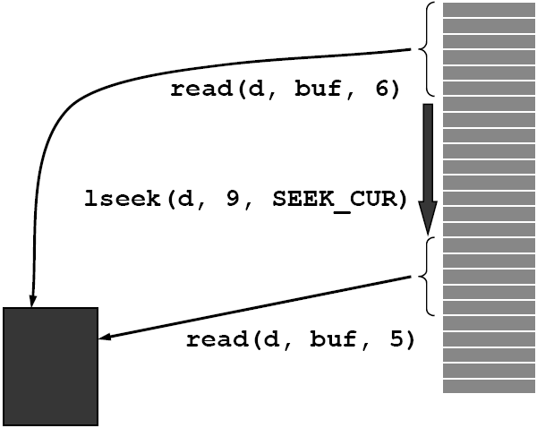
Files – access methods
Buffer
in the
memory
file
Mariusz Pelc © 2012/2013
(with support from Dr Kevin McManus and Cos Ierotheou)

Slide 13
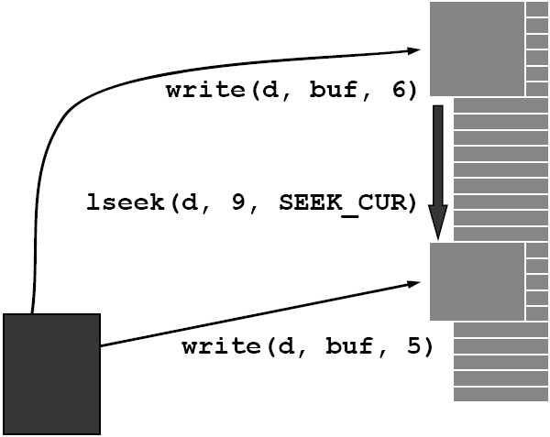
Files – access methods
Buffer
in the
memory
file
Mariusz Pelc © 2012/2013
(with support from Dr Kevin McManus and Cos Ierotheou)

Slide 14
File Systems – organisation
Zones (volumens/partitions)
A logical device is created
Can refer to a part of one device or many physical devices
Can contain files and directories
For each zone a set of metadata is created describing directories and files allocation tables; these metadata is intialised at the file system creation (logial formatting)
Mariusz Pelc © 2012/2013
(with support from Dr Kevin McManus and Cos Ierotheou)

Slide 15
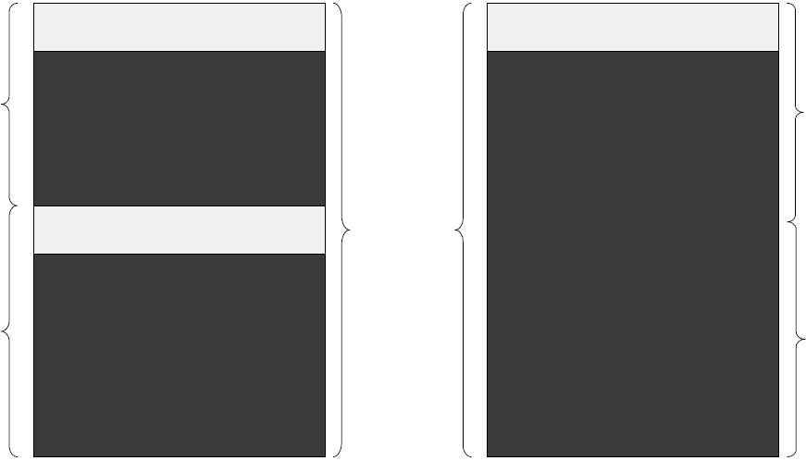
File Systems – organisation - Zones
Device Directory
Device Directory
Zone A
Drive A
Files
Drive
Zone
Device Directory
Files
Zone B
Drive B
Files
Mariusz Pelc © 2012/2013
(with support from Dr Kevin McManus and Cos Ierotheou)

Slide 16
File Systems – organisation
Directories
A directory is a table that ties filenames with directory entries
Directories can be of:
One level structure (all entries are placed at the same level – all names in the directore have to be unique)
Two level structure (directories cannot contain directories)
Tree structure (directories can contain directories)
A-cyclic graph (one file/directory can be placed in many locations)
Generic graph (a cycle is allowed in links between directories)
Mariusz Pelc © 2012/2013
(with support from Dr Kevin McManus and Cos Ierotheou)

Slide 17
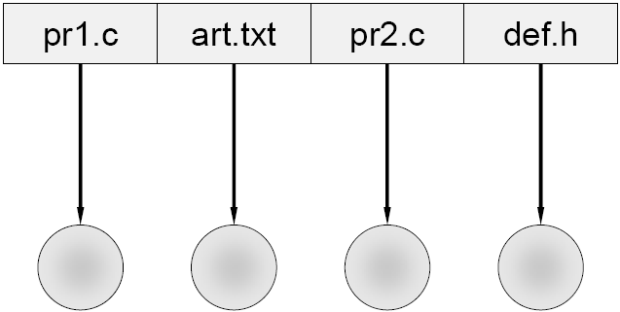
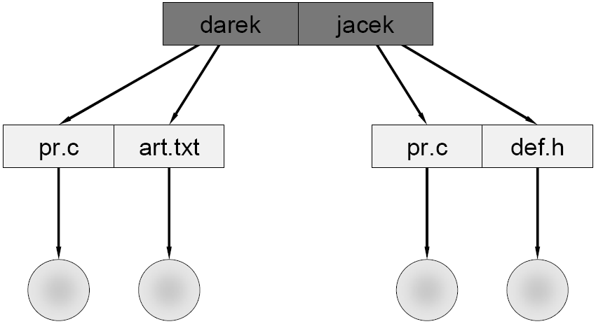
File Systems – organisation - directories
One level structure
Two level structure
Mariusz Pelc © 2012/2013
(with support from Dr Kevin McManus and Cos Ierotheou)

Slide 18
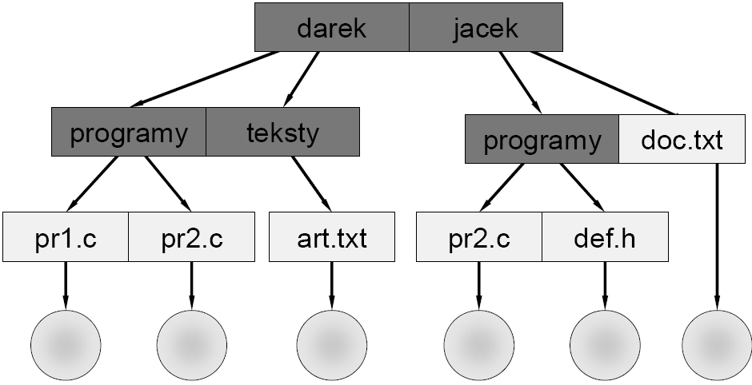
File Systems – organisation - directories
Tree structure
Mariusz Pelc © 2012/2013
(with support from Dr Kevin McManus and Cos Ierotheou)

Slide 19
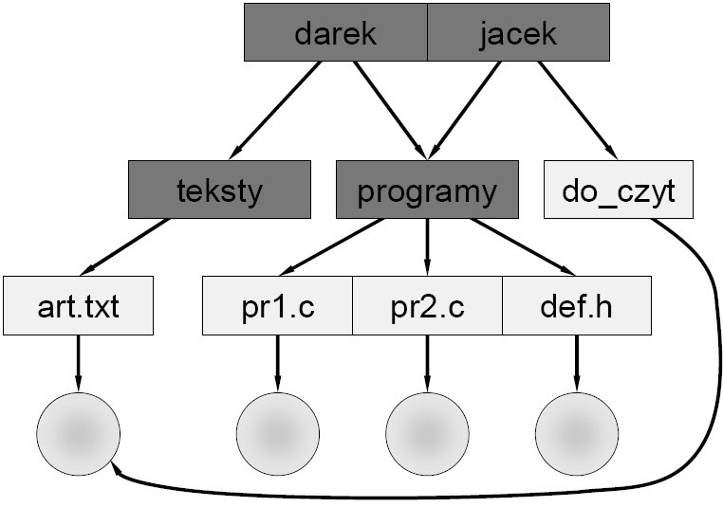
File Systems – organisation - directories
A-cyclic
graph
Mariusz Pelc © 2012/2013
(with support from Dr Kevin McManus and Cos Ierotheou)

Slide 20
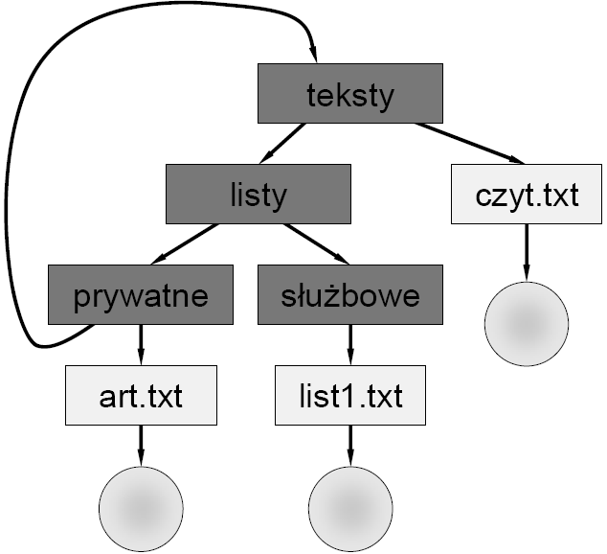
File Systems – organisation - directories
Generic
graph
Mariusz Pelc © 2012/2013
(with support from Dr Kevin McManus and Cos Ierotheou)

Slide 21
Operating systems functions
Operating System maps the abstract data reflection to a physical location on a device
Operating System additionally provides:
File identificaiton (in a directory structure)
Interface for operations on files
A way of access to the files/directories guaranteeing data security (synchronisation, authentication), integrity and efficienty
Mariusz Pelc © 2012/2013
(with support from Dr Kevin McManus and Cos Ierotheou)

Slide 22
File Systems – Methods of files allocation
Contiguous allocation
single set of blocks is allocated to a file at the time of creation
only a single entry in the file allocation table
starting block and length of the file
External fragmentation will occur
Not the most flexible of systems
Mariusz Pelc © 2012/2013
(with support from Dr Kevin McManus and Cos Ierotheou)

Slide 23
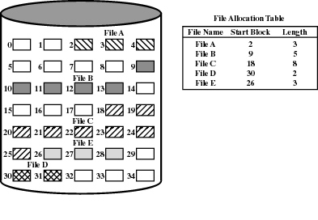
File Systems – Methods of files allocation
Mariusz Pelc © 2012/2013
(with support from Dr Kevin McManus and Cos Ierotheou)

Slide 24
File Systems – Methods of files allocation
Chained allocation
allocation on basis of individual block
each block contains a pointer to the next block in the chain
only single entry in the file allocation table
starting block and length of file
No external fragmentation
Best for sequential files
No accommodation of the principle of locality
Mariusz Pelc © 2012/2013
(with support from Dr Kevin McManus and Cos Ierotheou)

Slide 25
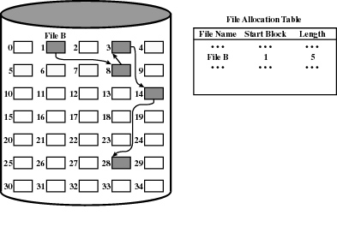
File Systems – Methods of files allocation
Before consollidation
Mariusz Pelc © 2012/2013
(with support from Dr Kevin McManus and Cos Ierotheou)

Slide 26
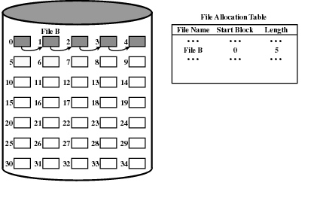
File Systems – Methods of files allocation
After consollidation
Mariusz Pelc © 2012/2013
(with support from Dr Kevin McManus and Cos Ierotheou)

Slide 27
File Systems – Methods of files allocation
Indexed allocation
File Allocation Table (FAT) contains a separate one-level index for each file
Mariusz Pelc © 2012/2013
(with support from Dr Kevin McManus and Cos Ierotheou)

Slide 28
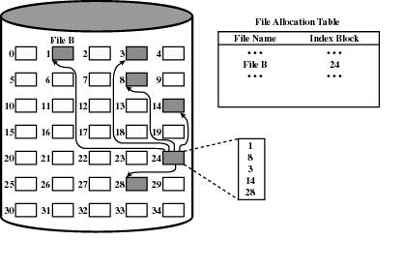
File Systems – Methods of files allocation
After consollidation
Mariusz Pelc © 2012/2013
(with support from Dr Kevin McManus and Cos Ierotheou)

Slide 29
File Systems – Methods of files allocation
i-nodes
index-node stores file attributes and disk addresses of the blocks
last address points to a disk block containing additional addresses
only the i-nodes for open files need to be in memory
Mariusz Pelc © 2012/2013
(with support from Dr Kevin McManus and Cos Ierotheou)

Slide 30
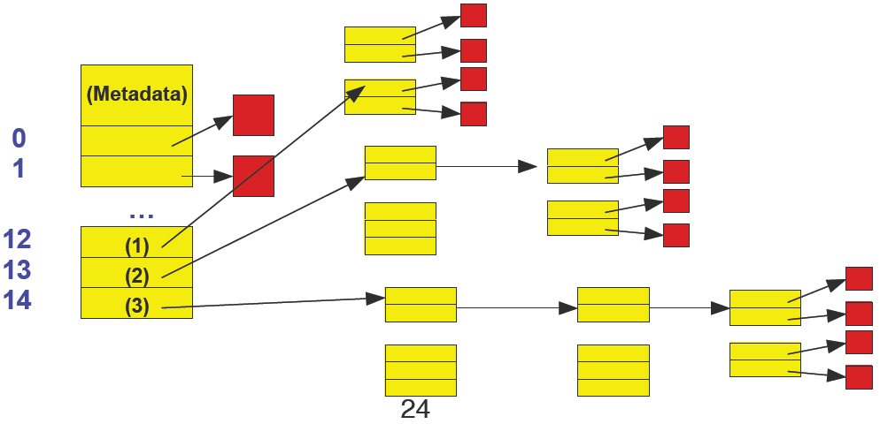
File Systems – Methods of files allocation
Linux i-nodes
Mariusz Pelc © 2012/2013
(with support from Dr Kevin McManus and Cos Ierotheou)

Slide 31
File Systems – Linux
Types of files
ordinary - user, system, ASCII, binary...
directory
special - devices
character /dev/mouse
block /dev/hda0
named - pipes
Choice of file systems
UFS, ex2fs
Journalling, e.g. AdvFS, JFS, XFS, ReiserFS
Mariusz Pelc © 2012/2013
(with support from Dr Kevin McManus and Cos Ierotheou)

Slide 32
File Systems – NT/XP
Key features of NTFS
journalling
recoverability (Unix fsck)
security (Unix + acl)
large disks and large files
In comparison to FAT
multiple data streams
Mac compatible
general indexing facility
Index by attribute
Mariusz Pelc © 2012/2013
(with support from Dr Kevin McManus and Cos Ierotheou)

Slide 33
File Systems – network/distributed file systems
Distributed file systems
Sun NFS
heterogeneous networks
ietf standard
centralise storage
minimise local storage requirements
thin clients
simplifies system admin
software installs
backups
transparent
automount
unlike M$
Mariusz Pelc © 2012/2013
(with support from Dr Kevin McManus and Cos Ierotheou)

Slide 34
File Systems – Fairsite
A Microsoft Research project for a networked file system
goals
highly available, reliable file service on ordinary desk tops
ensure privacy and data integrity with no central authority
self configuring, self tuning, failure resistant
for who?
enterprise with 10⁵ machines with 10¹⁰ files – such as a university
requires low latency, high bandwidth networks
Mariusz Pelc © 2012/2013
(with support from Dr Kevin McManus and Cos Ierotheou)

Slide 35
File Systems – Fairsite
Highly distributed directory
Low replication of files
files have no fixed abode
files migrate to where they are required
single (triple) instance files
increases capacity through removal of redundancy
files are encrypted to ensure security on partially trusted networks
Mariusz Pelc © 2012/2013
(with support from Dr Kevin McManus and Cos Ierotheou)

Slide 36
File Systems – Longhorn
Codename for Micro$oft’s successor to Windoze XP
Integrates SQL server into the operating system
No more files
paradigm shift – everything becomes an object (cf. Unix)
objects exposed through .NET
Not backward compatible
another chance for Billy to yank your chain
Mariusz Pelc © 2012/2013
(with support from Dr Kevin McManus and Cos Ierotheou)

Slide 37
File Systems – Files Sharing
File sharing has been around since timesharing
Easy to do on a single machine
PCs, workstations, and networks get us there (mostly)
File sharing is incredibly important for getting work
done
Basis for communication and synchronization
Two key issues when sharing files
Semantics of concurrent access
What happens when one process reads while another writes?
What happens when two processes open a file for writing?
Protection
Mariusz Pelc © 2012/2013
(with support from Dr Kevin McManus and Cos Ierotheou)

Slide 38
File Systems – Access Rights
None
user is not allowed to read the user directory that includes the file
Knowledge
user can only determine that the file exists and who its owner is
Execute
the user can execute a program but cannot copy it
Read
the user can read the file for any purpose, including copying and execution
Mariusz Pelc © 2012/2013
(with support from Dr Kevin McManus and Cos Ierotheou)

Slide 39
File Systems – Access Rights
Append
the user can add data to the file but cannot modify or delete any of the file’s contents
Update
the user can modify, delete, and add to the file’s data.
Change access
user can change access rights granted to other users
Delete
user can delete the file
Mariusz Pelc © 2012/2013
(with support from Dr Kevin McManus and Cos Ierotheou)

Slide 40
File Systems – Access Rights
File Owner
has all rights previously listed
may grant rights to others using the following classes of users
specific user
user groups
all for public files
Access control may be intrinsic or via access control list
setfacl, getfacl
Mariusz Pelc © 2012/2013
(with support from Dr Kevin McManus and Cos Ierotheou)

Slide 41
File Systems – Access Rights (simultaneus access)
User may lock entire file when it is to be updated
User may lock the individual records during the update
Mutual exclusion and deadlock are issues for shared access
Mariusz Pelc © 2012/2013
(with support from Dr Kevin McManus and Cos Ierotheou)

Slide 42
File Systems – Protection
File systems implement some kind of protection
system
Who can access a file
How they can access it
More generally…
Objects are “what”, subjects are “who”, actions are “how”
A protection system dictates whether a given action
performed by a given subject on a given object should
be allowed
You can read and/or write your files, but others cannot
You can read “/etc/motd”, but you cannot write it
Mariusz Pelc © 2012/2013
(with support from Dr Kevin McManus and Cos Ierotheou)

Slide 43
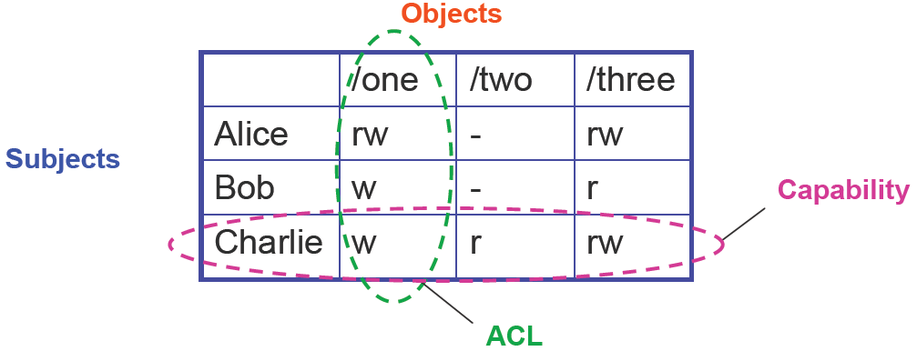
File Systems – Protection
Access Control Lists (ACL)
For each object, maintain a list of subjects and their permitted actions
Capabilities
For each subject, maintain a list of objects and their permitted actions
Mariusz Pelc © 2012/2013
(with support from Dr Kevin McManus and Cos Ierotheou)

Slide 44
File Systems – ACLs and Capabilities
The approaches differ only in how the table is represented
What approach does Unix use?
Capabilities are easier to transfer
They are like keys, can handoff, does not depend on subject
In practice, ACLs are easier to manage
Object-centric, easy to grant, revoke
To revoke capabilities, have to keep track of all subjects that have the capability – a challenging problem
ACLs have a problem when objects are heavily shared
The ACLs become very large
Use groups (e.g., Unix)
Mariusz Pelc © 2012/2013
(with support from Dr Kevin McManus and Cos Ierotheou)

